Slide 1
Bank Marketing Dataset

Slide 2
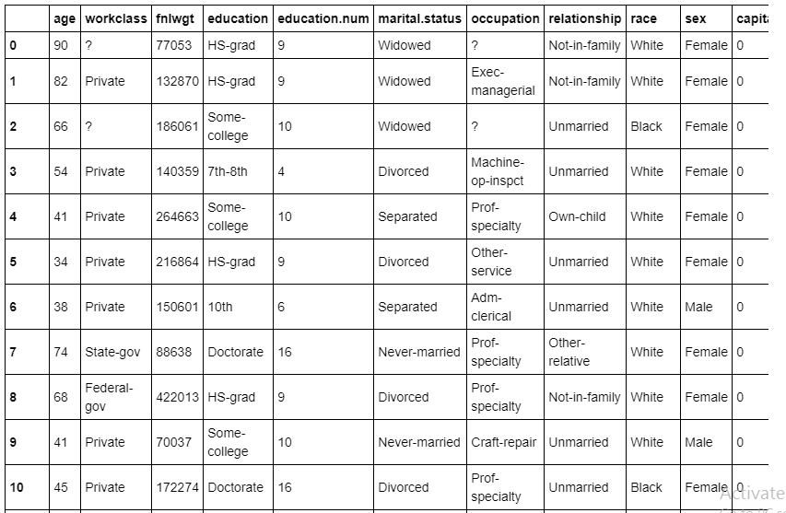
Data Analysis
Target: classification goal is to predict if the income is above or below 50k

Slide 3
Feature Description
Age
Workclass
Fnlwgt
Education
Education.num
Marital.status
Occupation

Slide 4
Relationship
Race
Sex
Capital.gain
Capital.loss
Hours.per.week
Native.country
Income

Slide 5
Features Selected
Target variable: Income
Feature Variable: Education.num,Workclass, Education, Age, Occupation, Race, Sex

Slide 6
Visualization

Slide 7

Confusion Matrix

Slide 8
Accuracy Metrics
Accuracy: 0.79
Precision: 0.66
Recall: 0.35
Sepicificity: 0.94
F1 Score: 0.46

Slide 9
Thank You

